Slide 1
Program Evaluation and Review Technique & Critical Path Method

Slide 2
Project Management: AN OVER view
Composed of Job, Activities and Functions (Tasks)
One Specific purpose: Starts at some specific moment and finishes when objectives have been full filled
For Completion: Material and manpower resources
Role of management: deals with both
Specific objectives:
Should be completed within a minimum time
Should use all resources as sparingly as possible
Should be completed with a minimum of capital investment

Slide 3
Three phases:
Project planning
Project Scheduling
Project controlling

Slide 4
Role of decision in project management
If a poor decision is made and a wrong road is chosen none but luckiest survive
Steps:
Identify : the central problem
Develop : alternatives
Analyse : alternatives
Make : final decision

Slide 5
Technique: Operation Research
A set of mathematical techniques through which a variety of organizational problems can be solved
→Net work diagrams
→Various names(PERT,CPM)
PERT: basically developed by the navy Special Project office for evaluating the feasibility of existing schedules on Polaris missile program and for reporting progress

Slide 6
pert
Uses event oriented network diagrams
An event : particular instant of time at which some specific part of a plan is to be achieved.
Does not require any resources
Preffered for
non repetitive projects &
précises time determination for various activities can not be made

Slide 7
cpm
Consists of clearly recognizable job called activities
Activities: → take time to carry out & resources are expended
→ Junction between activities are event
→ Represented by an arrow
Generally use for repetitive projects
Fairly accurate estimate of time for completion of each activity can be made

Slide 8
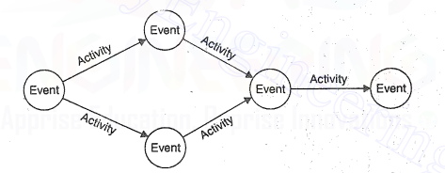
Net work diagrams

Slide 9
An example
Laying foundation
Excavation
Laying side boards
Concreting

Slide 10
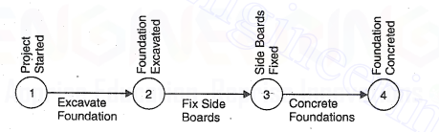
Simple network diagrams

Slide 11
Example 2:
Consider a project of purchasing a new heavy duty lathe and disposing of old lathe
Activities:
Await delivery of lathe
Remove existing lathe
Install power supply
Install lathe
Connect to power
Test
Dispose of existing lathe

Slide 12
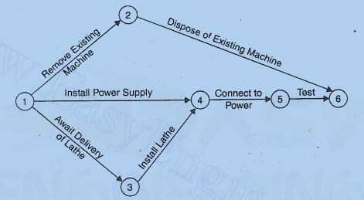
Activity oriented

Slide 13
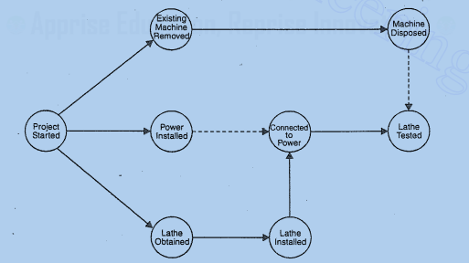
Event oriented

Slide 14
Predecessor
An event that occurs before another event
For eg: ‘project started is an immediate predecessor for -----
Successor
An event that follows another event

Slide 15
Operation management techniques: PERT and CPM
The methods are essentially network-oriented techniques
basically time-oriented methods
In CPM activities are shown as a network of precedence relationships using activity-on node network construction (where each activity is represented by a node )
Single estimate of activity time
Deterministic activity times
Control for time and costs
Used IN: for the jobs of repetitive in nature

Slide 16
In PERT activities are shown as a network of precedence relationships using activity-on arrow network construction (each activity is represented by an arc)
Multiple time estimates
Probabilistic activity times
Used IN: for non-repetitive jobs, where the time and cost estimates tend to be quite uncertain (uses probabilistic time estimates)

Slide 17
Benefits:
Useful at many stages of project management
Mathematically simple
Give critical path and slack time
Provide project documentation
Useful in monitoring costs

Slide 18
Steps
Define the Project and all of its significant activities or tasks. The Project (made up of several tasks) should have only a single start activity and a single finish activity.
Develop the relationship among the activities. Decide which activities must precede and which must follow others
Draw the ‘network’ connecting all the activities. Each activity should have a unique event number.
Assign time and/or cost estimates to each activity
Compute the longest time path through the network. This is called the critical path.
Use the Network to help plan, schedule, and monitor and control the project

Slide 19
An example
The RELIABLE CONSTRUCTION COMPANY has just made the winning bid of $5.4 million to construct a new plant for a major manufacturer. The manufacturer needs the plant to go into operation within a year. Therefore, the contract incudes the following provisions:
• A penalty of $300,000 if Reliable has not completed construction by the deadline 47 weeks from now.
• To provide additional incentive for speedy construction, a bonus of $150,000 will be paid to Reliable if the plant is completed within 40 weeks.

Slide 20
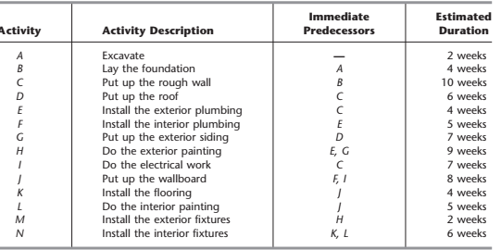
Activity list

Slide 21
Probable questions
Immediate predecessors: Activities must be completed by no later than the starting time of the given activity. Immediate predecessors can be more than one.
1. How can the project be displayed graphically? 2. What is the total time required to complete the project if no delays occur? 3. When do the individual activities need to start and finish (at the latest) to meet this project completion time? 4. When can the individual activities start and finish (at the earliest) if no delays occur? 5. Which are the critical bottleneck activities? 6. For the other activities, how much delay can be tolerated without delaying project completion?

Slide 22
How can the project be displayed graphically?
Using project network-→ consists of a number of nodes and arcs

Slide 23
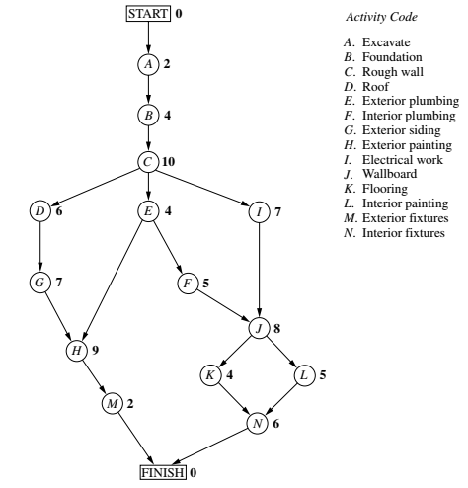

Slide 24
2. What is the total time required to complete the project if no delays occur? 3. When do the individual activities need to start and finish (at the latest) to meet this project completion time? 4. When can the individual activities start and finish (at the earliest) if no delays occur? 5. Which are the critical bottleneck activities? 6. For the other activities, how much delay can be tolerated without delaying project completion?

Slide 25
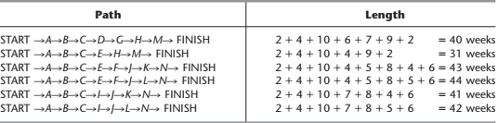
Critical path
Sum total of duration all the activities = 79 weeks
We have several paths with several lengths ( 31 to 44 weeks)
Critical path: the project duration will be equal to the length of the longest path.

Slide 26
Scheduling individual activities
By addressing question 4
When can the individual activities start and finish if no delays occur? (ES & EF)
Having no delays means:
The actual duration of each activity= estimated duration
Each activity begins as soon as all its immediate predecessors are finished
EF= ES+ (estimated duration of activity)
For Activity A: ES=0
EF= 0+ duration (2 weeks)= 2
Activity B can start as soon as A finishes
Activity B: ES= 2
EF= 2 + duration= 2+4 = 6 weeks

Slide 27
If an activity has only a single immediate predecessor, then ES for the activity = EF for the immediate predecessor
If an activity has more than one immediate predecessors, then ES for the Activity is the largest among them

Slide 28
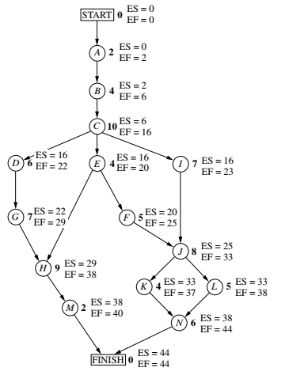

Slide 29
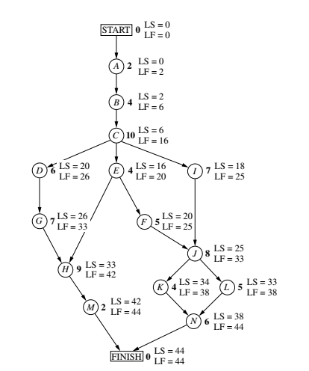

Slide 30
Identifying slack in the schedule
Slack: it indicates how long an activity can be delayed beyond the earliest time schedule without delaying the completion of the project
S( 38,42)
F(40,44)
Slack= LF-EF= 44-40=4
Zero slack indicate any delays in this activity delays the project completion
M

Slide 31
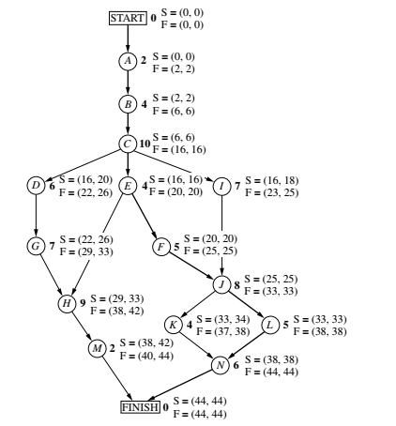
slack

Slide 32
Best Wishes

